Slide 1
Processes and operating systems
Multiple tasks and multiple processes.
Specifications of process timing.
Preemptive real-time operating systems.
Processes and UML.

Slide 2
Reactive systems
Respond to external events.
Engine controller.
Seat belt monitor.
Requires real-time response.
System architecture.
Program implementation.
May require a chain reaction among multiple processors.

Slide 3
Tasks and processes
A task is a functional description of a connected set of operations.
(Task can also mean a collection of processes.)
A process is a unique execution of a program.
Several copies of a program may run simultaneously or at different times.
A process has its own state:
registers;
memory.
The operating system manages processes.
P1
P2
P3

Slide 4
Why multiple processes?
Multiple tasks means multiple processes.
Processes help with timing complexity:
multiple rates
multimedia
automotive
asynchronous input
user interfaces
communication systems

Slide 5
Multi-rate systems
Tasks may be synchronous or asynchronous.
Synchronous tasks may recur at different rates.
Processes run at different rates based on computational needs of the tasks.

Slide 6
Example: engine control
Tasks:
spark control
crankshaft sensing
fuel/air mixture
oxygen sensor
Kalman filter
engine
controller

Slide 7
Typical rates in engine controllers
Variable | Full range time (ms) | Update period (ms)
Engine spark timing | 300 | 2
Throttle | 40 | 2
Air flow | 30 | 4
Battery voltage | 80 | 4
Fuel flow | 250 | 10
Recycled exhaust gas | 500 | 25
Status switches | 100 | 20
Air temperature | Seconds | 400
Barometric pressure | Seconds | 1000
Spark (dwell) | 10 | 1
Fuel adjustment | 80 | 8
Carburetor | 500 | 25
Mode actuators | 100 | 100

Slide 8
Real-time systems
Perform a computation to conform to external timing constraints.
Deadline frequency:
Periodic.
Aperiodic.
Deadline type:
Hard: failure to meet deadline causes system failure.
Soft: failure to meet deadline causes degraded response.
Firm: late response is useless but some late responses can be tolerated.

Slide 9
Timing specifications on processes
Release time: time at which process becomes ready.
Deadline: time at which process must finish.

Slide 10
Release times and deadlines
deadline
deadline
P1
P1
P1
time
period
initiating
event
period
aperiodic process
periodic process initiated
by event
periodic process initiated
at start of period

Slide 11
Rate requirements on processes
Period: interval between process activations.
Rate: reciprocal of period.
Initiation rate may be higher than period---several copies of process run at once.
CPU 1
P1₁
CPU 2
P1₂
CPU 3
P1₃
CPU 4
P1₄
time

Slide 12
Timing violations
What happens if a process doesn’t finish by its deadline?
Hard deadline: system fails if missed.
Soft deadline: user may notice, but system doesn’t necessarily fail.

Slide 13
Example: Space Shuttle software error
Space Shuttle’s first launch was delayed by a software timing error:
Primary control system PASS and backup system BFS.
BFS failed to synchronize with PASS.
Change to one routine added delay that threw off start time calculation.
1 in 67 chance of timing problem.

Slide 14
Task graphs
Tasks may have data dependencies---must execute in certain order.
Task graph shows data/control dependencies between processes.
Task: connected set of processes.
Task set: One or more tasks.
P1
P2
P5
P3
P6
P4
task 1
task 2
task set

Slide 15
Communication between tasks
Task graph assumes that all processes in each task run at the same rate, tasks do not communicate.
In reality, some amount of inter-task communication is necessary.
It’s hard to require immediate response for multi-rate communication.
MPEG system layer
MPEG audio
MPEG video

Slide 16
Process execution characteristics
Process execution time T_{i}.
Execution time in absence of preemption.
Possible time units: seconds, clock cycles.
Worst-case, best-case execution time may be useful in some cases.
Sources of variation:
Data dependencies.
Memory system.
CPU pipeline.

Slide 17
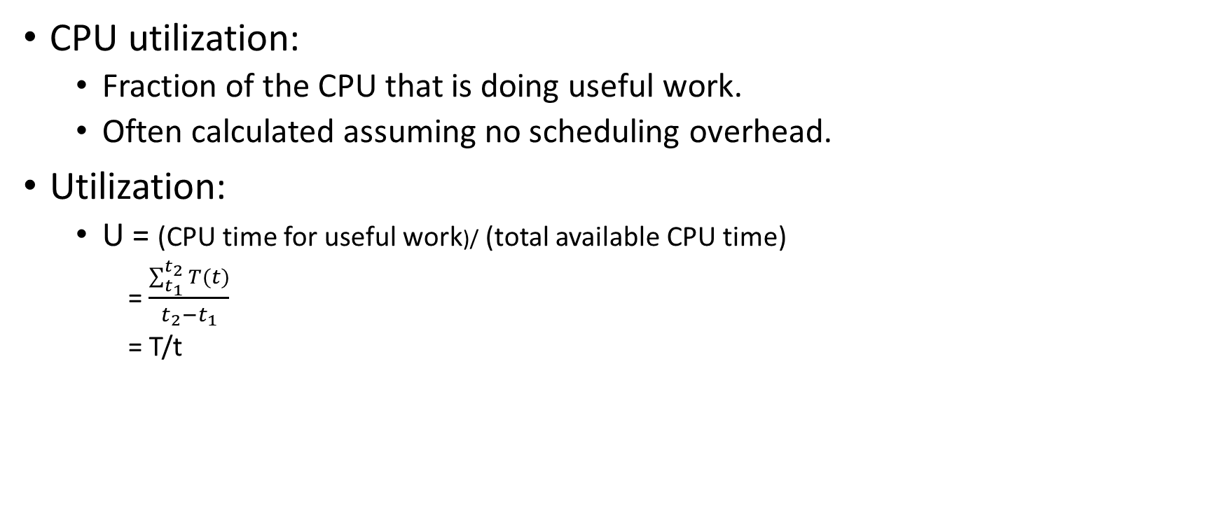
Utilization
CPU utilization:
Fraction of the CPU that is doing useful work.
Often calculated assuming no scheduling overhead.
Utilization:
U = (CPU time for useful work)/ (total available CPU time)
= $\frac{\sum_{t_{1}}^{t_{2}}{T(t)}}{t_{2}−t_{1}}$
= T/t

Slide 18
State of a process
A process can be in one of three states:
executing on the CPU;
ready to run;
waiting for data.
executing
gets data
and CPU
gets
CPU
preempted
needs
data
gets data
ready
waiting
needs data

Slide 19
The scheduling problem
Can we meet all deadlines?
Must be able to meet deadlines in all cases.
How much CPU horsepower do we need to meet our deadlines?

Slide 20
Scheduling feasibility
Resource constraints make schedulability analysis NP-hard.
Must show that the deadlines are met for all timings of resource requests.
P1
P2
I/O device

Slide 21
Simple processor feasibility
Assume:
No resource conflicts.
Constant process execution times.
Require:
T ≥ Σ_{i} T_{i}
Can’t use more than 100% of the CPU.
T₁
T₂
T₃
T

Slide 22
Hyperperiod
Hyperperiod: least common multiple (LCM) of the task periods.
Must look at the hyperperiod schedule to find all task interactions.
Hyperperiod can be very long if task periods are not chosen carefully.

Slide 23
Hyperperiod example
Long hyperperiod:
P1 7 ms.
P2 11 ms.
P3 15 ms.
LCM = 1155 ms.
Shorter hyperperiod:
P1 8 ms.
P2 12 ms.
P3 16 ms.
LCM = 96 ms.

Slide 24
Simple processor feasibility example
P1 period 1 ms, CPU time 0.1 ms.
P2 period 1 ms, CPU time 0.2 ms.
P3 period 5 ms, CPU time 0.3 ms.

Slide 25
Cyclostatic/TDMA
Schedule in time slots.
Same process activation irrespective of workload.
Time slots may be equal size or unequal.
T₁
T₂
T₃
T₁
T₂
T₃
P
P

Slide 26
TDMA assumptions
Schedule based on least common multiple (LCM) of the process periods.
Trivial scheduler -> very small scheduling overhead.
P₁
P₁
P₁
P₂
P₂
P_{LCM}

Slide 27
TDMA schedulability
Always same CPU utilization (assuming constant process execution times).
Can’t handle unexpected loads.
Must schedule a time slot for aperiodic events.

Slide 28
TDMA schedulability example
TDMA period = 10 ms.
P1 CPU time 1 ms.
P2 CPU time 3 ms.
P3 CPU time 2 ms.
P4 CPU time 2 ms.

Slide 29
Round-robin
Schedule process only if ready.
Always test processes in the same order.
Variations:
Constant system period.
Start round-robin again after finishing a round.
T₁
T₂
T₃
T₂
T₃
P
P

Slide 30
Round-robin assumptions
Schedule based on least common multiple (LCM) of the process periods.
Best done with equal time slots for processes.
Simple scheduler -> low scheduling overhead.
Can be implemented in hardware.

Slide 31
Round-robin schedulability
Can bound maximum CPU load.
May leave unused CPU cycles.
Can be adapted to handle unexpected load.
Use time slots at end of period.

Slide 32
Schedulability and overhead
The scheduling process consumes CPU time.
Not all CPU time is available for processes.
Scheduling overhead must be taken into account for exact schedule.
May be ignored if it is a small fraction of total execution time.

Slide 33
Running periodic processes
Need code to control execution of processes.
Simplest implementation: process = subroutine.

Slide 34
while loop implementation
Simplest implementation has one loop.
No control over execution timing.
while (TRUE) {
p1();
p2();
}

Slide 35
Timed loop implementation
Encapuslate set of all processes in a single function that implements the task set,.
Use timer to control execution of the task.
No control over timing of individual processes.
void pall(){
p1();
p2();
}

Slide 36
Multiple timers implementation
Each task has its own function.
Each task has its own timer.
May not have enough timers to implement all the rates.
void pA(){ /* rate A */
p1();
p3();
}
void B(){ /* rate B */
p2();
p4();
p5();
}

Slide 37
Timer + counter implementation
Use a software count to divide the timer.
Only works for clean multiples of the timer period.
int p2count = 0;
void pall(){
p1();
if (p2count >= 2) {
p2();
p2count = 0;
}
else p2count++;
p3();
}

Slide 38
Cooperative multitasking in PIC16F887
Timing is controlled by timer 0.
Enabled by T0IE.
Global variable timer_flag tells main() when timer is done.
void interrupt timer_handler() {
if (T0IE && T0IF) {
timer_flag = 1;
T0IF = 0;
}
main() {
init();
while (1) {
if (timer_flag) {
task1();
task2();
task3();
timer_flag = 0;
}
}
}

Slide 39
Implementing processes
All of these implementations are inadequate.
Need better control over timing.
Need a better mechanism than subroutines.

